Slide 1

Migrating Traditional Business Rules Applications to the Cloud
Alexander Schmidt
aschmidt@inrule.com
http://www.inrule.com
April 20, 2010
Notes:
Good evening, colleagues!
It’s a pleasure to see you there and today we going to talk about migration of the traditional business rules applications to the cloud.
Conference URL: http://www.cloudslamevent.com/migrating-traditional-business-rules-applications-cloud

Slide 2
Overview
Introduction to BRE and Cloud
Objectives and Solution
Performance and Scalability
Simulation in the Cloud
Advantages and Conclusions
Notes:
We will see a brief introduction in the business rule applications and cloud, review objectives and proposed solutions.
After that we will review performance and scalability issues with the business rule applications, perform a few simulations, and finally, review advantages and draw conclusions about the topic of today’s presentation.

Slide 3
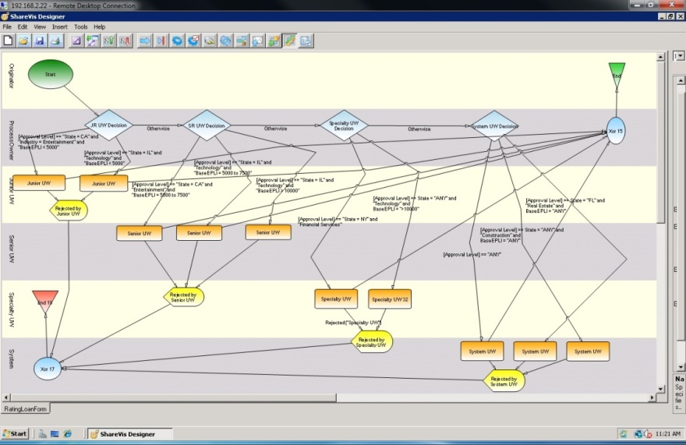







Introduction to Business Rules
Where Business Rules Are Found
Processes
Mainframe
Systems
Spreadsheets
& Documents
Databases
Application
Code
Components of a Business Rule Management System (BRMS)
Authoring
Create and test business processes using business rules
Rule Repository
Store, organize,
report and audit
business policies
Rule Execution and Monitoring
Deploy and monitor automated business policies as they execute.
Notes:
A typical business rule management system (BRMS) enables organizational policies and the operational decisions associated with those policies – to be defined, deployed, monitored and maintained separately from core application code. By externalizing business rules and providing tools to manage them, a BRMS allows business experts to define and maintain the decisions that guide systems behavior, reducing the amount of time and effort required to update production systems, and increasing the organization’s ability to respond to changes in the business environment.
Authoring allows creating and testing business processes using business rules, decision tables, and other elements.
Repository allows reusing these business rules, report, and perform audits of the defined processes.
Rule Engine services the business rules applications and provides deployment, execution, and monitoring facilities throughout the lifetime of a business rule application.
More info at http://www.inrule.com/products/InRule.aspx

Slide 4
Introduction to the Cloud
Cloud computing is Internet-based computing, whereby shared resources, software and information are provided to computers
and other devices
on-demand, like a
public utility.
3 major players:
Microsoft Azure
Amazon Elastic Cloud
Google App Engine
Cloud Application
Application
Compute
Storage
Config
Fabric
Notes:
Cloud computing is Internet-based computing, whereby shared resources, software and information are provided to computers
and other devices on-demand, like a public utility. There are three major players in the Cloud computing sphere which are:
Microsoft’s Windows Azure platform is a group of cloud technologies, each providing a specific set of services to application developers.
Amazon Elastic Cloud allows users to rent virtual computers on which to run their own computer applications
Google App Engine is a platform for developing and hosting web applications in Google-managed data centers.
Off note, IBM’s public Cloud infrastructure is based on Red Hat Enterprise Virtualization (RHEV) stack based on the Kernel-Based Virtual Machine (KVM). but it’s not supporting the facilities required for our purposes.
A typical cloud application consists of the application logic itself configured to perform specific business logic. To perform this action, it uses storage for persisting data. The cloud application is executed in the fabric, consisting of a number of instances which are engaged and dismissed according to the necessities.

Slide 5
Objectives
Minimize TCO
Simplify BR management
Rules rollout should be quick
Rules repository
Travel and transportation
Healthcare
Logistics
Banking
Finances
Insurance
Notes:
There are number industries using rules in some form or another listed on the right and the following objectives are essential in deciding how Cloud can help:
Reduction of time and resources required to deploy changes. Companies want to pay only for what you use and when you use, i.e. cents per hour and GB stored versus hundreds per month and hundreds per box setup. It provides flexibility & agility in quick and self-service provisioning such that developers no longer waiting on IT to respond and eases and speeds up application development.
Business experts want to manage and validate decision logic easier. All environments are easily accessible through firewalls and data so that it can be managed across boundaries and tested for dependencies.
We are looking at improving process efficiency through faster rules rollout which is crucial for changing requirements
We want to ensure compliance and enable sharing/re-use of decision logic by using rules repository.

Slide 6
Towards BRMS Service Bus
Ruleapps are discoverable, other departments within an organization, i.e. feduciary, risk
management can get access,
perform audit etc.
Can become a knowledge base that
is extendable as new services are added to
the service bus, a step towards SaaS.
Better security due to
centralization of data,
increased security-focused resources, etc.
Great opportunity for applications
in different industries including
Health, R&D, Education.
Notes:
How can applications in other organizations (or even in other parts of your own) find endpoints they can connect to for your services? It would be nice to have some kind of registry where others could locate your application. BRMS Service Bus fills this gap, ruleapps are discoverable, converging to a knowledge base. This is a great opportunity for applications in different industries, i.e. Healthcare, R&D, and Education besides those mentioned previously.

Slide 7
Public vs. Private Cloud
Public Cloud
Private Cloud
Add Web service capabilities to existing packaged applications
Build, modify, and distribute applications to the Web with minimal on-premises resources
Perform services (large-volume storage, batch processing, intense or large-volume computations, etc.) off premises
Create, test, debug, and distribute Web services quickly and inexpensively
Reduce costs of building and extending on-premises resources
Reduce the effort and costs of IT management
Management of the datacenter fabric as a single pool of resources.
Delivery of scalable applications and workloads.
Focus on the management of the datacenter service and it’s dependencies.
Notes:
With the Microsoft cloud strategy, organizations can now move towards cloud computing models with the confidence that their existing investments in their datacenter are safe, and can be leveraged in this new paradigm. Existing applications and services will be able to move to the private cloud without the need to learn unproven technologies, or introduce unnecessary complexity. At the same time Microsoft will evolve its private cloud offerings by bringing learning and technology from running Microsoft’s global datacenters and the Windows® Azure platform into a technology known as Dynamic Infrastructure Toolkit for System Center. DIT-SC is a forthcoming Microsoft provided Solution Accelerator for optimizing data center operations, appears to be raising more questions than it’s answering. Formerly known as the Dynamic Data Center Toolkit for Enterprises (DDCT-E), the renamed solution is meant to provide a free, partner-extensible framework for creating agile, virtualized infrastructures. It will be available during the first half of 2010. More info can be found at http://www.microsoft.com/virtualization/en/us/private-cloud.aspx http://download.microsoft.com/download/D/D/3/DD35D5A7-1B78-4277-BCB6-0027A0196775/FAQ_DIT-SC_Jan2010_updated.docx
This technology is planned to be announced at Microsoft Management Summit 2010 at http://www.mms-2010.com/public/home.aspx

Slide 8
Solution
Traditional BRMS migration to Cloud
Parallel execution of rule applications (rule app and rule parallelism)
Cloud-based rule repository
Architecture Overview
Functional Overview
Notes:
The solution of the described problem set is to migrate BRMS and integrate it tightly with the Cloud.
To address performance and scalability, parallel execution of the rule applications and rule parallelism can be leveraged.
Finally, the obvious choice is to migrate the repository to the Cloud.
Now we will look at potential architecture of such a solution followed by a functional overview of the proposed approach.

Slide 9
Architecture Overview
AooFabric
Server
AooFabric
Server
RuleApp
RuleApp
RuleApp
Schema
Repository
Entities
EndPoints
State
Xml Schema
Data
SDS
Rules
Calculations
Vocabulary
Microsoft Azure
Decision
tables
Constraints
Notes:
The proposed solution, which represents typical cloud configuration consists of the several appfabric servers, where each runs its own rule application with some state attached to it. The repository is the storage medium providing a copy of the rule application when it should be refreshed or stored for later use. The repository is based on the SQL Data Services provided by Microsoft, which is a part of the Microsoft Azure platform. An AppFabric server is running on the Microsoft Azure platform as well.
A typical rule application consists of the schema and a set of rules describing the automated business process. Schema consists of the entities, Endpoints, Xml Schemas, and other schema defining elements. Rules are described via rulesets, or function-based expressions similar to what might be found in Microsoft Excel, actions, Matrix-style or graphical-based decision tables, Hierarchical and sequential flows of conditions and actions or flows of other rules Constraints to determine data quality or validity, Classifications, and other rule elements.

Slide 10
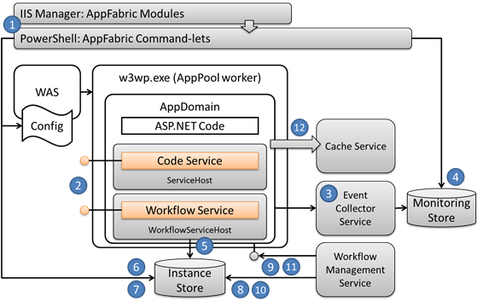
Functional Overview
AppFabric Modules
1
PowerShell: AppFabric Command-lets
WAS
W2wp.exe (AppPool worker)
2
Cache Service
Config
AppDomain
ASP.NET Code
3
Monitoring
Store
4
Event Management
Service
Rule app Modules
Code Service
Rule Engine
Workflow Service
Workflow
Management
Service
Repository
Notes:
The functional overview of the proposed solution consists of the following components:
1) In the Windows Server AppFabric provides application server capabilities to introduce enhanced application hosting and administration tooling (previously codename “Dublin”) for services written using WCF and WF programming models, and providing distributed cache capabilities (previously codename “Velocity”) for .NET applications. AppFabric enables long-running workflows by a) saving workflow state in an instance store and b) exposing administrative commands such as suspend, resume, terminate on long-running workflow instances.
2) Supporting services such as cache, event management are available at developers disposal.
3) Monitoring store and repository are there for the persistence.
4) Rule and modules of the business rule application can be integrated in the code service and workflow service.

Slide 11
Performance and Scalability
Breaking down into chunks
  Working Memory
  Network
State management
  Retrieving State
  Storing State
Optimizations
  Rete Algorithm (caching, logic optimiz.)
  Sequential vs. Parallel rule execution
Notes:
The following are the most important factors affecting the performance and scalability of a rule applications.
State grows with the complexity of a rule application so that the challenge here is to pass the updates between cluster nodes where it can be done in most optimal way. State can be offloaded from the engine and passed to the consuming nodes in xml format, which can be compressed, or even diff-ed to minimize the traffic.
Among possible optimizations is use of caching, logic optimization, It’s worth noting that most BREs are based on the Rete algorithm, which is orientated to scenarios where forward chaining and ‘inferencing’ is used to calculate new facts from existing facts, or to filter and discard facts in order to arrive at some conclusion. It is also exploited as a reasonably efficient mechanism for performing highly combinatorial evaluations of facts where large numbers of joins must be performed between fact tuples. Other approaches to performing rule evaluation, such as the use of decision trees, or the implementation of sequential engines, may be more appropriate for simple scenarios, and should be considered as possible alternatives.
Parallel rule execution seems reasonable to apply inside the engine so to be able to improve the performance of the rule applications. We’re currently investigating possible optimizations in this area and most likely will be able to archieve some improvements in a near term.

Slide 12
Repository Provider for the Cloud
Design
Easy to design and implement since relational storage is provided.
Provides highly available and secure service which is easy to program and provision.
Implementation
.Net-based, developers with right skills are there
Possible to provide cloud-based service that can be used by either on-premises applications or global applications.
Maintanance
Users can avoid capital expenditure on hardware, software and services.
Microsoft’s data centers frees the enterprise from the responsibility and expense of managing its own servers, turning capital expenses into operating expenses.
If the application has spikes in usage—maybe it’s an on-line store that must handle the holiday rush—letting Microsoft maintain the large server base required for this can make economic sense.
Can be accessed from anywhere, handles the challenges of getting through firewalls without opening new ports for exposed applications.
Tighter integration with existing components.
Notes:
To improve rule reuse and reduce time and resources required to deploy changes in a rule application, we propose to implement repository in the Cloud.
Design:
Since the Microsoft vision of the cloud incorporates the features of providing the relational storage,
we may be able to create a catalog provider which can be based on this storage.
The existing interface will be retained and no major changes in the design will need to be introduced.
Implementation:
Possible to provide cloud-based services that can be used by either on-premises applications or cloud applications. Filling this gap is the goal of Cloud.
Maintanance:
Users can avoid capital expenditure on hardware, software and services, rather paying a provider only for what they use.
Less headache with managing the servers.
Application has spikes in usage, letting Microsoft maintain the large server base required for this can make economic sense.
Let us draw a line here and see what can be accomplished for the existing business rule management system. The efficacy of the proposed novel approaches is demonstrated by solving a number of test problems.

Slide 13
Simulation
Goals
  Verify BRMS in the Cloud
  Evaluate performance and scalability
  Check architecture decisions affecting BRE applications specific to Cloud
Methods
  A sample ruleapp executed in the Cloud (AppFabric, Service Bus)
  Repository in the Cloud
Notes:
Moreover, we’d like to set the following goals for our experiments:
Verify practically that the deployment of the BRMS to the Cloud can be accomplished without major hassles
Evaluate performance and scalability of the proposed solution and compare it with the traditional deployment into on-premises environment
Check architecture decisions which can affect the BRE specific in the deployment scenario to the Cloud
To accomplish these goals we will create a sample rule application, deploy it to the cloud and measure the performance.
Also, we will configure the repository in the Cloud and using tools connect to it to perform typical operations while measuring the performance of those.
Lets move the sample rule application designed for the Cloud.

Slide 14
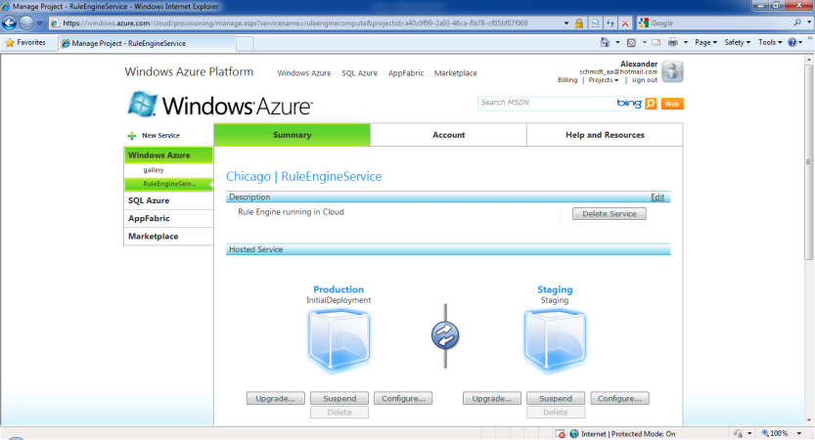
A sample ruleapp executed in the Cloud
Rule application with an entity
Entity contains 2 fields and
returns sum of both as a result
// Create the rule app
RuleApplicationDef ret = new RuleApplicationDef("Demo");
// Add Entity
EntityDef entity1 = new EntityDef("TestEntity");
ret.Entities.Add(entity1);
// Add Fields
entity1.Fields.Add(new FieldDef("Value1", DataType.Number));
entity1.Fields.Add(new FieldDef("Value2", DataType.Number));
entity1.Fields.Add(new FieldDef("Result", "Value1 + Value2", DataType.Number));
return ret;
Notes:
The sample rule application consists of an entity with 2 fields with a result of both returned after execution of our application. Here is how the code looks like for our application . The resulting problem was deployed to the Cloud using deployment mechanisms provided in Azure.

Slide 15
Sample Ruleapp Statistics
Tests performed in
  On-premises environment
    Intel Core i5, 4GB, 2.27 GHz
    1 Instance
  Cloud environment
    Windows Azure Guest OS 1.2
    10 Instances
Notes:
The tests were performed in an on-premises environment running on commodity hardware which is Intel-based, has 4 GB of RAM, and running at 2.27 GHz, and running on a single instance. After that we executed the sample application in the cloud environment running on Windows Azure Guest OS version 1.2 and running 10 instances of AppFabric. The results are collected into graph presented on the right.

Slide 16
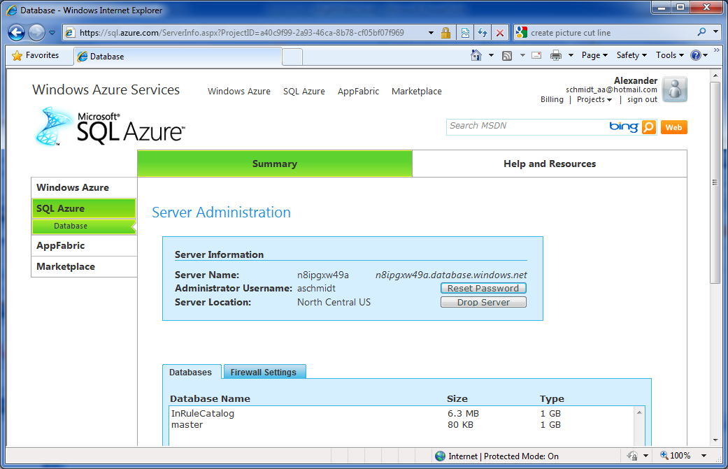
Repository in the Cloud
Local DB
SQL Azure
Notes:
A second test was in designing and implementing a Cloud-based Repository. We used as a foundation an existing provider implemented in our BRMS. Because Azure provides relational infrastructure similar to the one available in regular SQL Server, the migration was pretty simple.

Slide 17
Repository in the Cloud Statistics
Goals
  Deploy repository to
  Cloud
  Measure performance
  of repository ops
Methods
  Test rule application 3.8MB
  Create, checkout, check in tests
Notes:
Our goals included possibility of such a migration with minimal changes to the code. The second goal was to measure performance of the typical repository operations and compare those with the operations performed against an instance of the repository running on-premises within a local network.
To accomplish that, we’ve used a test rule application with a number of rules and a few dozen of entities in the schema and performed measurements of the create, checkout, and check in operations on this rule application. The performance comparison is presented on the right.

Slide 18
SQL Azure vs. Local SQL Server
Not all features are supported
Replication and file management is automatic
Conceptually similar to an on-premise instance of SQL Server
Same Relational Data Model
Transact-SQL Features Supported | Transact-SQL Features Unsupported
Constants Constraints Cursors Index management and rebuilding indexes Local temporary tables Reserved keywords Stored procedures Statistics management Transactions Triggers Tables, joins, and table variables Transact-SQL language elements such as Create/drop databases Create/alter/drop tables Create/alter/drop users and logins and so on. User-defined functions Views, including sys.synonyms view | Common Language Runtime (CLR) Database file placement Database mirroring Distributed queries Distributed transactions Filegroup management Global temporary tables Spatial data and indexes SQL Server configuration options SQL Server Service Broker System tables Trace Flags
Notes:
SQL Azure offers the scale and functionality of an enterprise data center without the administrative overheads that are associated with on-premise instances of SQL Server. SQL Azure servers and databases are virtual objects that do not correspond to physical servers and databases. Hence, not all features available to the IT of on-premise servers. Conceptually similar to an on-premise instance of SQL Server and provides access to the same relational Data Model. The following table summarizes the Transact-SQL support provided by SQL Azure Database

Slide 19
Oracle in the Cloud
Oracle 11gR2 through Amazon Web Services (AWS)
Real Applications Cluster (RAC), Automatic Storage Management (ASM), and Storage Grid in the Cloud
Repository is similar to the one for SQL Server
Same product in the Cloud as the on-premises
AMI (Amazon Machine Image) is available
Notes:
Oracle database for repository can be accessed on the Amazon Cloud with a pre-installed Oracle 11gR2 Database and sample datasets. Oracle now can be launched an Oracle-enabled instance directly through Amazon Web Services (AWS) and connected to it using the standard OCI interface.

Slide 20
Repository Concept Shift
Cloud-based Repository implementation shifts to the ACE model
Notes:
NO-LONGER-APPLICABLE
SDS has two categories that defines where data will be, Authorities and Containers. Entities are like Records that has variety types of data. However, there are limitations. SDS is kind of simple DB, so there is no indexing and no relation information between entities.

Slide 21
Advantages and Conclusions
Centralized repository
Improved security (centralized)
Unlimited scalability
Recovery
Improved application performance
Minimized TCO
Notes:
To sum up, the advantages of the proposed approach is centralized repository which improves rule reuse and reduces time and resources required to deploy changes in a rule application. The security is more robust when it’s centralized and monitored in a unified manner rather than distributed throughout the multiple servers. The performance through virtually unlimited scalability without users having to engineer for peak loads is an important factor in adopting this technology. Reliability and recovery is greatly improved because apps are designed with a thought that if a task failed, it can be restarted without loosing work on other nodes. This leads to improved application performance as resource consumption is measured and computational resources and storage can be allocated as needed. The review of common problems with performance and scalability is presented in the context of business rules execution and possible optimizations in various scenarios. The experimental validation of the proposed ideas performed in a simulated environment, and then validated using AppFabric running on Microsoft Azure platform. The obtained results showed the feasibility of the proposed solution.

Slide 22
References:
  Windows Azure
    http://www.microsoft.com/windowsazure/
  Windows Server AppFabric Architecture
    http://blogs.msdn.com/endpoint/archive/2010/03/24/windows-server-appfabric-architecture.aspx
  Oracle in the Cloud
    http://www.oracle.com/technology/tech/cloud/pdf/oracle-in-the-cloud-datasheet.pdf
  Developing a Cloud-based Virtual Machine
    http://cloudslam09.com/content/developing-cloud-based-virtual-machine-81.html
  Migrating Traditional Business Rules Applications to the Cloud
    http://www.alexschmidt.net/research/migrating-traditional-bre-to-cloud.pdf
Notes:
These are the few resources which might be of interest to you.

Slide 23
Q&A
Notes:
Thank you of spending this time with me on this topic and now I’m ready to take your questions.

